Slide 1


for 3 Major Cities of the U.S.
Group 5
Tanmai Aurangabadkar
Neha Gupta
Era Singh Kajal
Ying Ying Lai
Professor
Jongwook Woo

Slide 2
Introduction/ Overview
Crime situation in the United States has always been an issue
Reason being: freedom to own weapons, poor economic situation
Los Angeles, New York and Chicago tops all major U.S. cities in crime issue

Slide 3
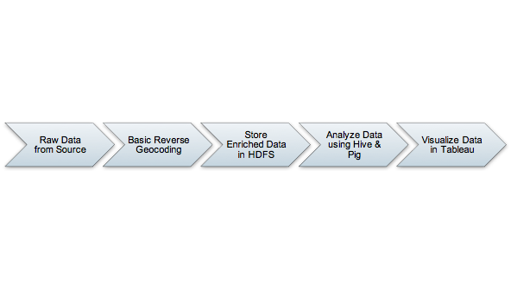







Architecture WorkFlow

Slide 4

H/W Experimental Specs
Cluster Version: IBM Analytics Engine
Number of Nodes: 2
Memory Size: 16 GB x2
CPU : 4vcpu x2
HDFS Disk : 600 GB x2

Slide 5

Data Size
3.1 GB
Data size > 3GB (GigaByte): Extra credit 1.5 out of 100% (1.5 points = 3GB x 0.5)
(Screenshot of dataset size in computer files properties)

Slide 6
Raw Data Source: Dataset URLs
Los Angeles
https://data.lacity.org/A-Safe-City/Crime-Data-from-2010-to-Present/y8tr-7khq New York
https://data.cityofnewyork.us/Public-Safety/NYPD-Complaint-Data-Historic/qgea-i56i Chicago
https://www.kaggle.com/currie32/crimes-in-chicago/data

Slide 7

Basic Reverse Geocoding FlowChart

Slide 8

New York

Slide 9
Facts about New York Crime Situation
The overall crime rate in NY is 28% lower than national average
For every 100,000 people, there are 5.58 daily crimes that occur in NY
NY is safer than 22% of the cities in the United States
In NY, you have a 1 in 50 chance of becoming a victim of any crime
(Provide proof/reference in term paper)

Slide 10
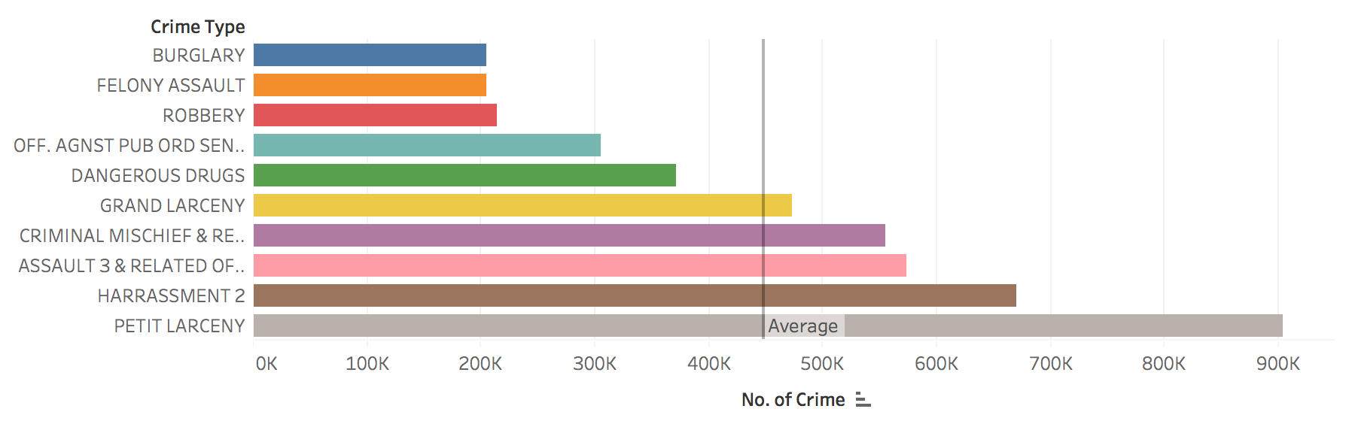
New York Top 10 Crime Types

Slide 11
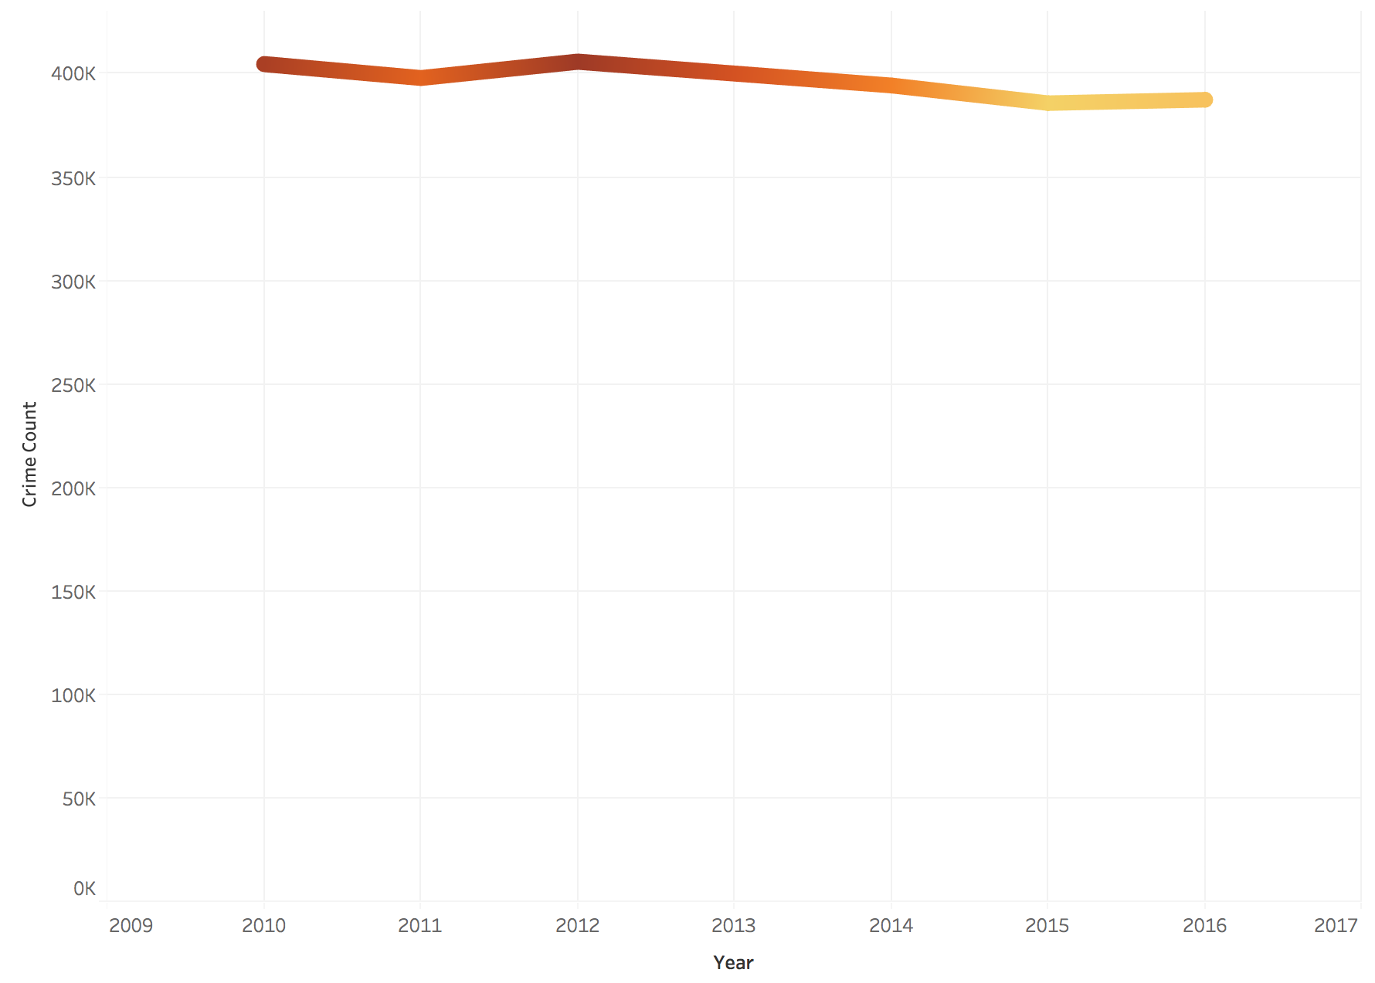
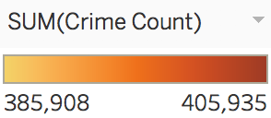
New York Crime Overview, by Year
Notes:
Change graph to 2010-2017

Slide 12
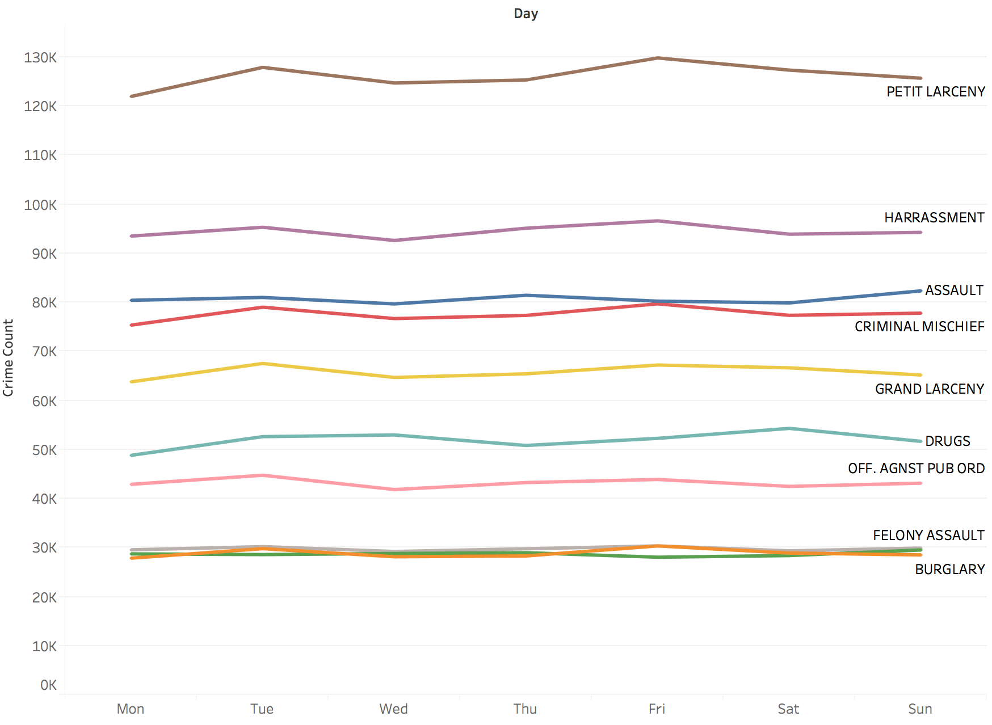
New York Crime Overview, by Day

Slide 13
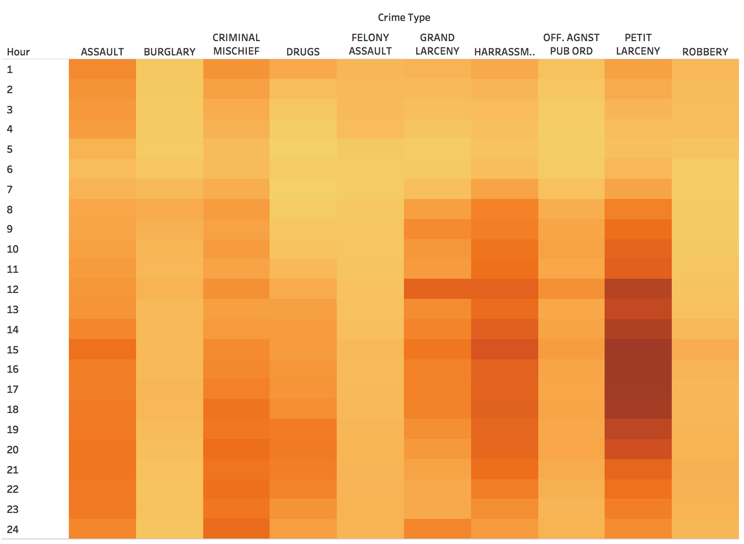
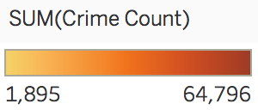
New York Crime Overview, by Hour

Slide 14
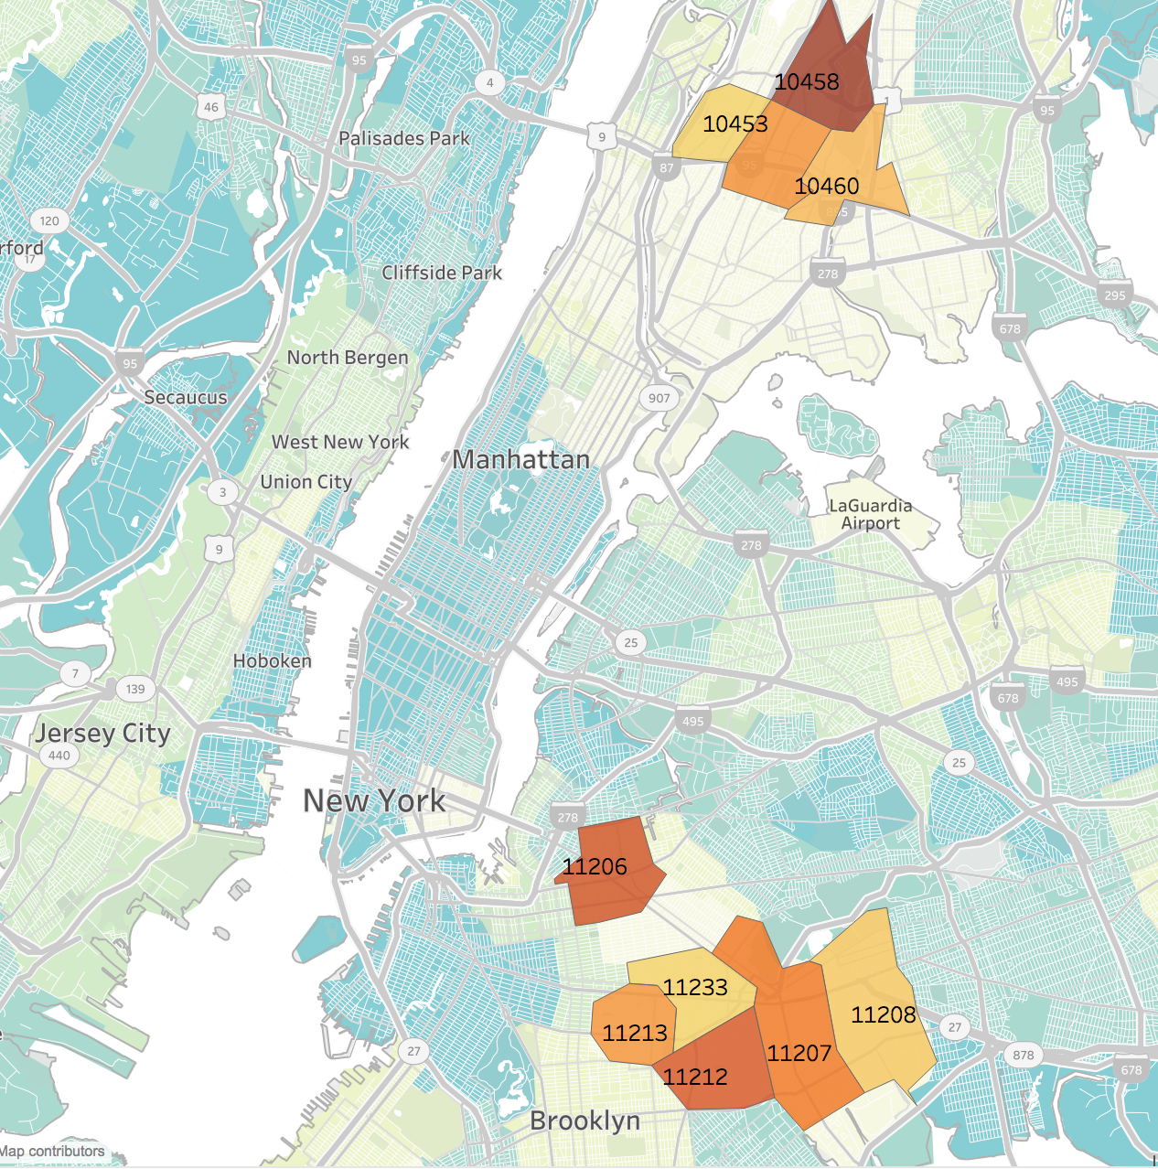
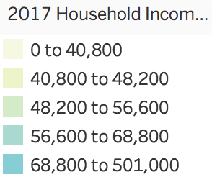
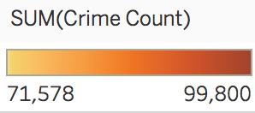
New York Crime Overview, by ZipCode

Slide 15

Los Angeles

Slide 16
Facts about Los Angeles Crime Situation
The overall crime rate in LA is 13% higher than national average
For every 100,000 people, there are 8.75 daily crimes that occur in LA
In LA, you have a 1 in 32 chance of becoming a victim of any crime
The number of total year over year crimes has increased by 7%

Slide 17
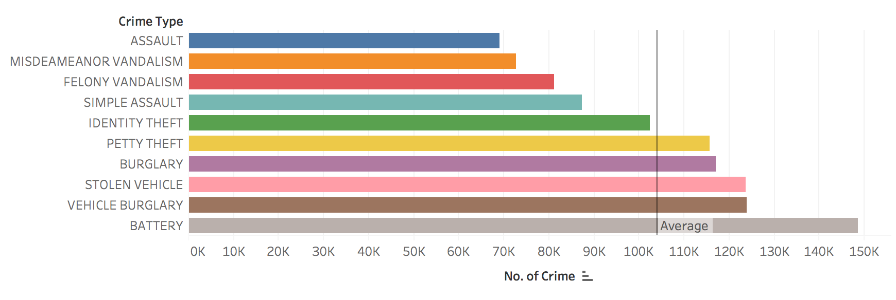
Los Angeles Top 10 Crime Types

Slide 18
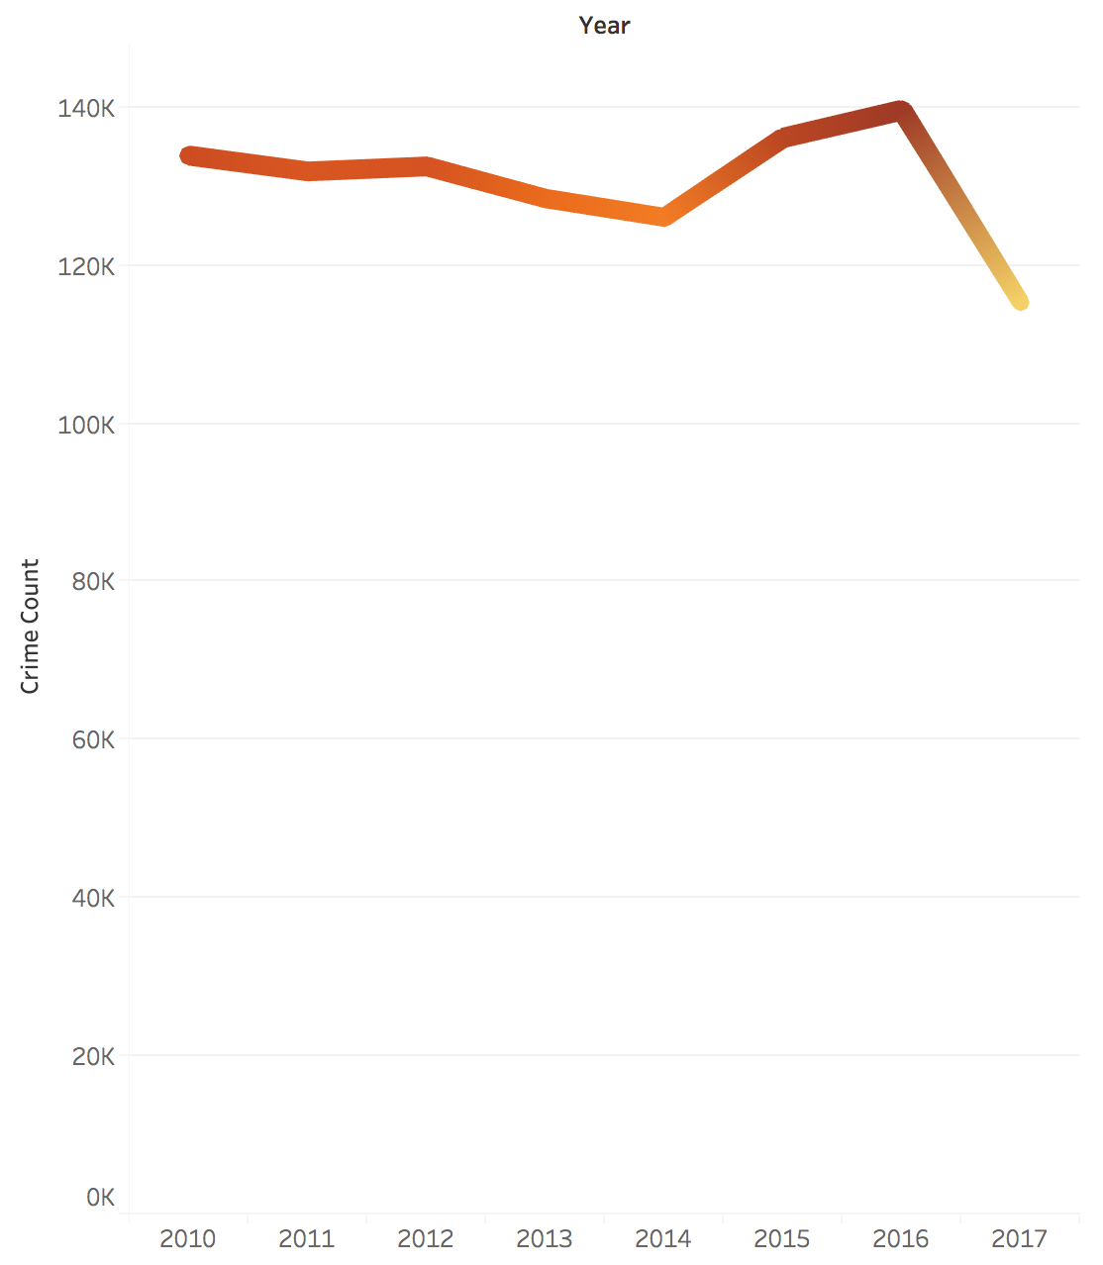
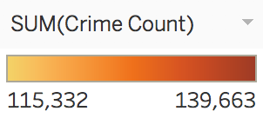
Los Angeles Crime Overview, by Year

Slide 19
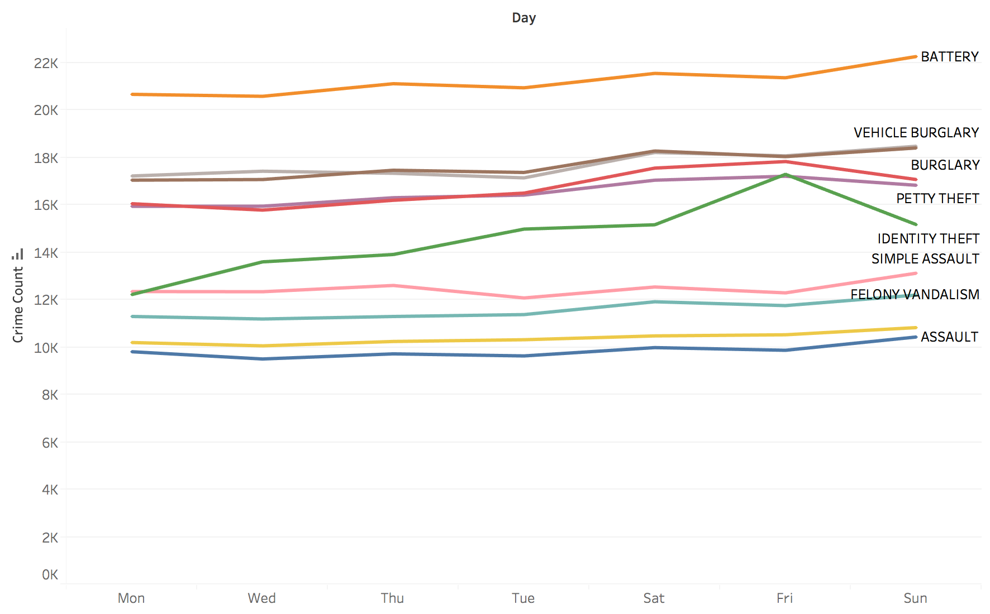
Los Angeles Crime Overview, by Day

Slide 20
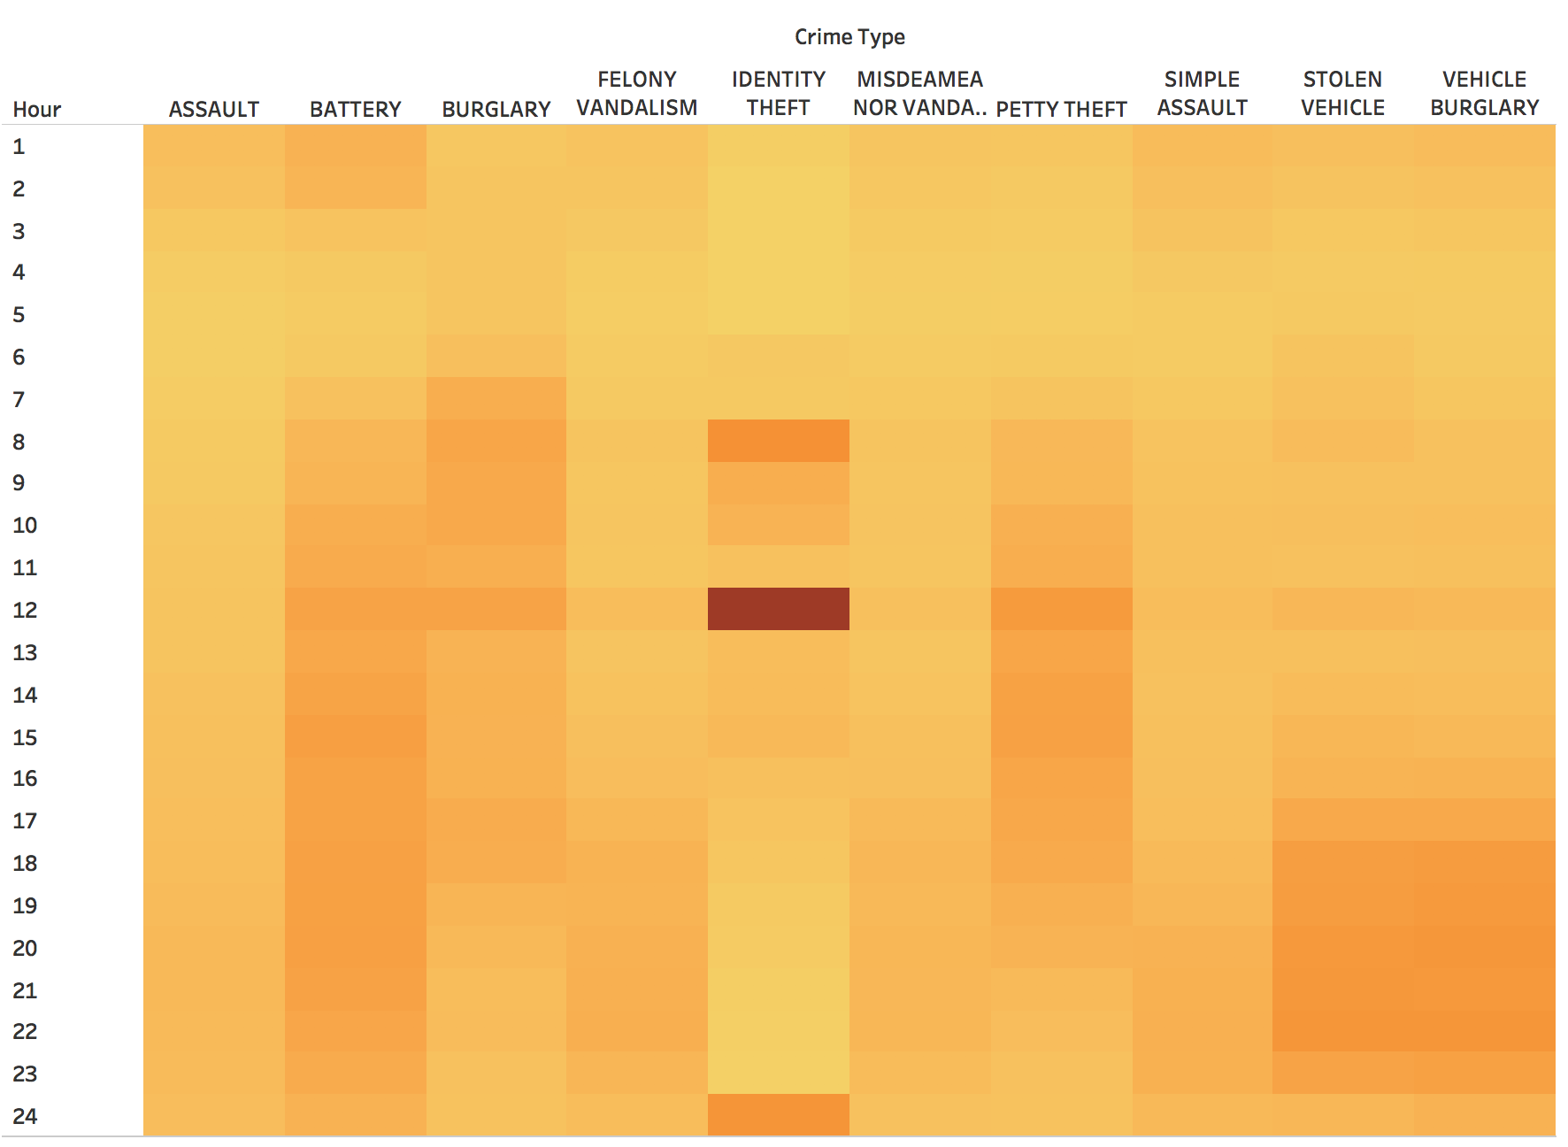
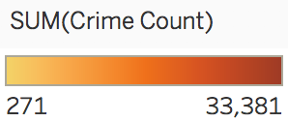
Los Angeles Crime Overview, by Hour

Slide 21
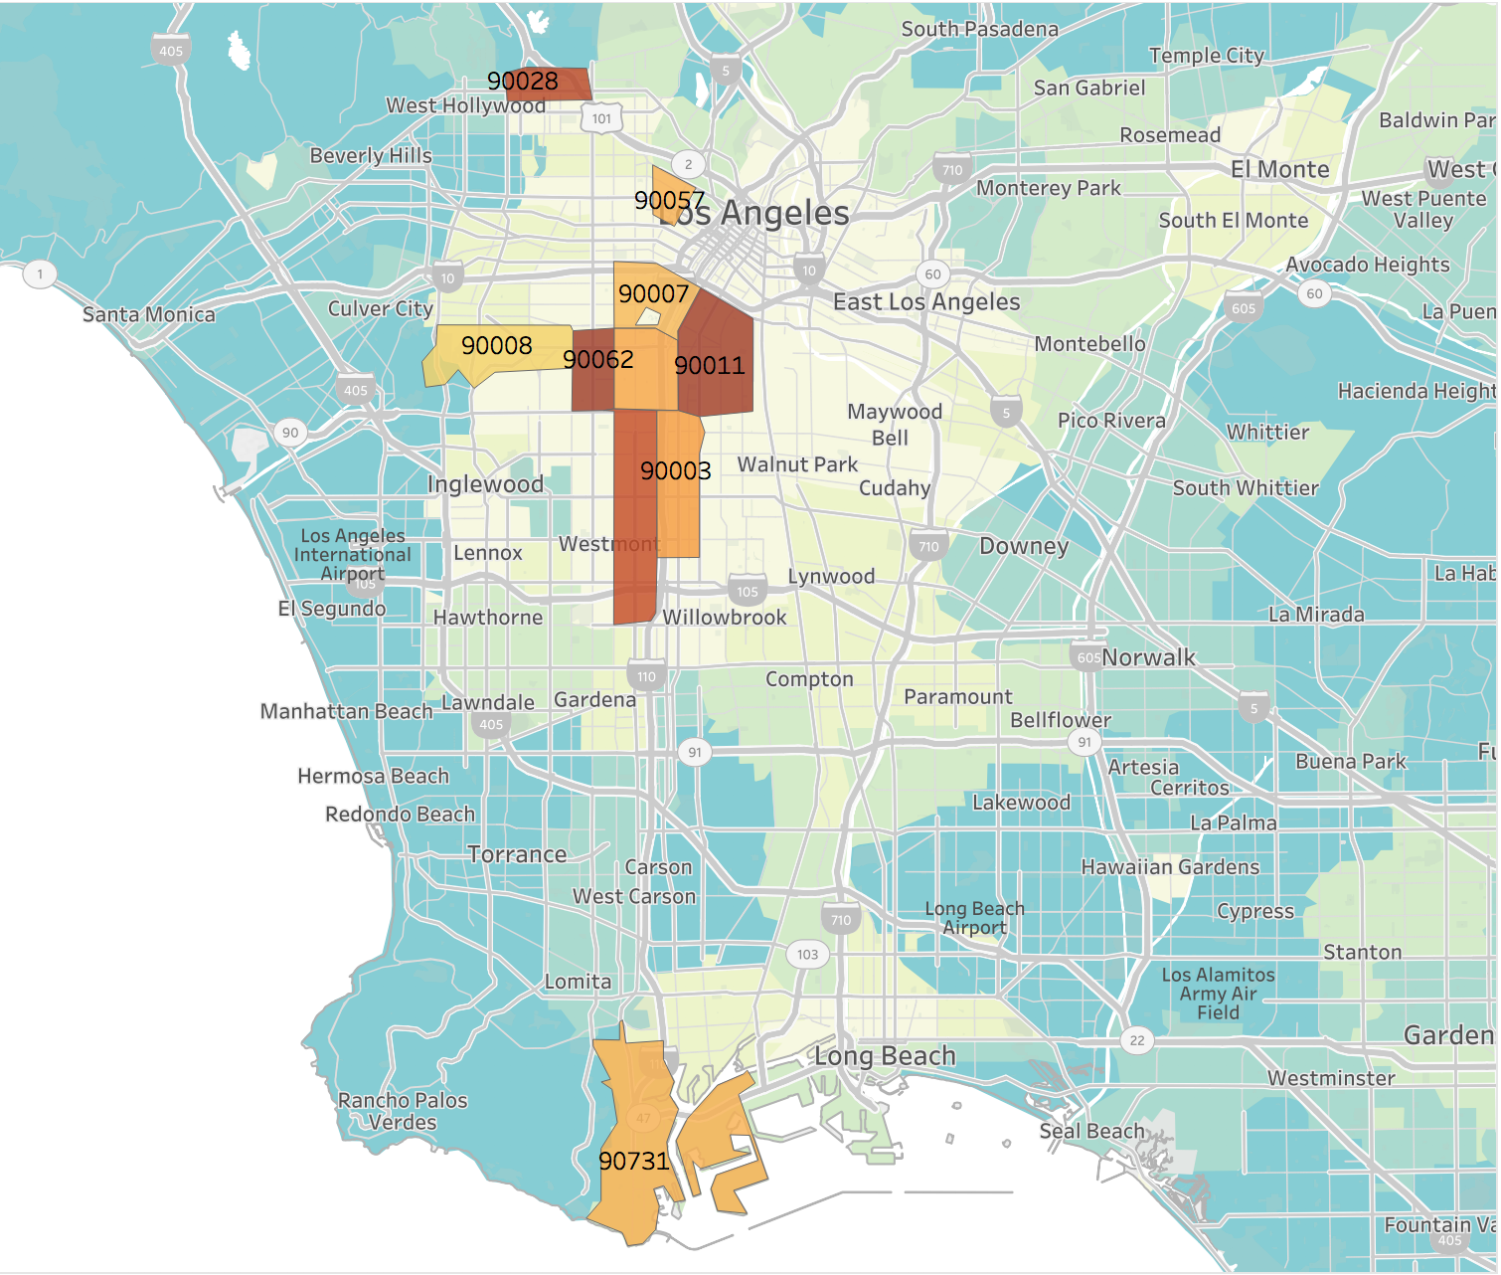
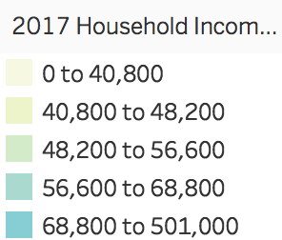
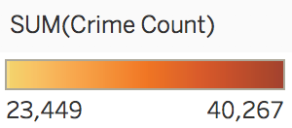
Los Angeles Crime Overview, by ZipCode

Slide 22

Chicago
(Standardize format of Chicago to look cohesive)

Slide 23
Facts about Chicago Crime Situation
The overall crime rate in Chicago is 51% higher than national average
For every 100,000 people, there are 11.77 daily crimes that occur in Chicago
Chicago is safer than 4% of the cities in the United States
In Chicago, you have a 1 in 24 chance of becoming a victim of any crime

Slide 24
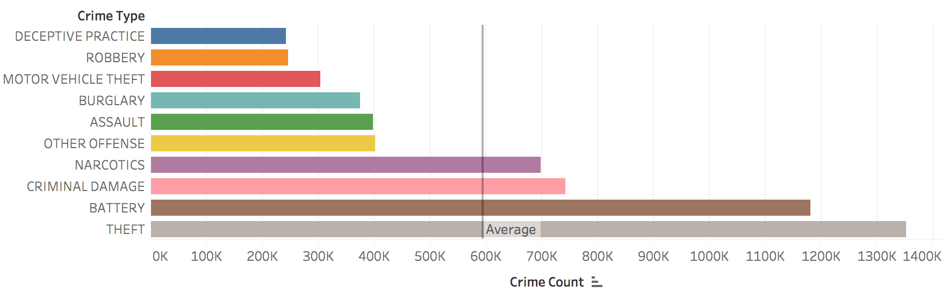
Chicago Top 10 Crime Types

Slide 25
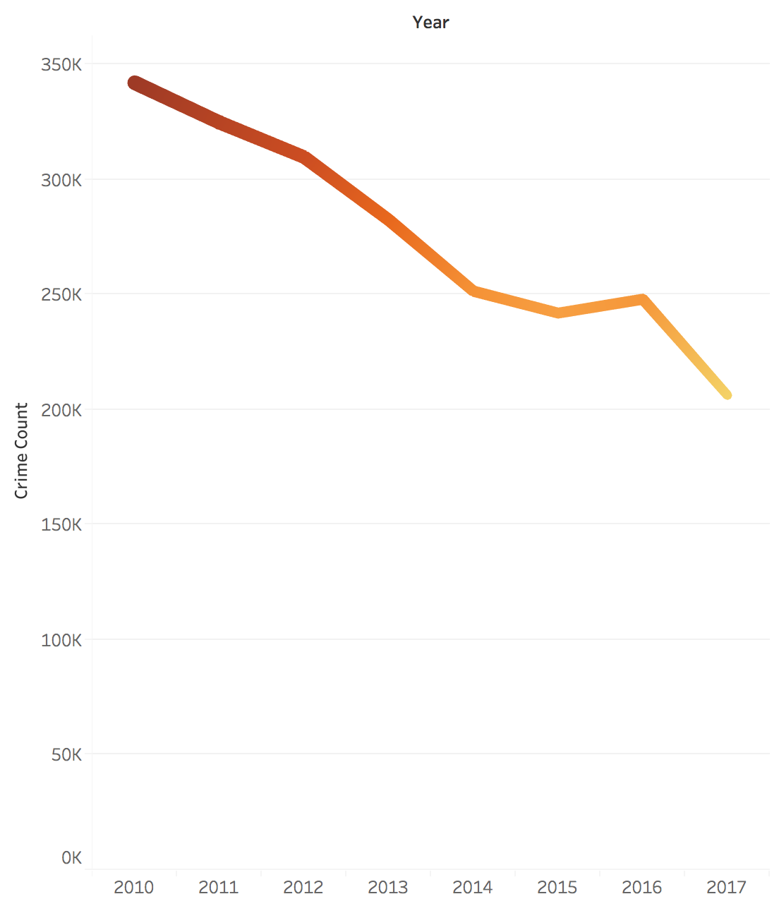
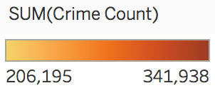
Chicago Crime Overview, by Year

Slide 26
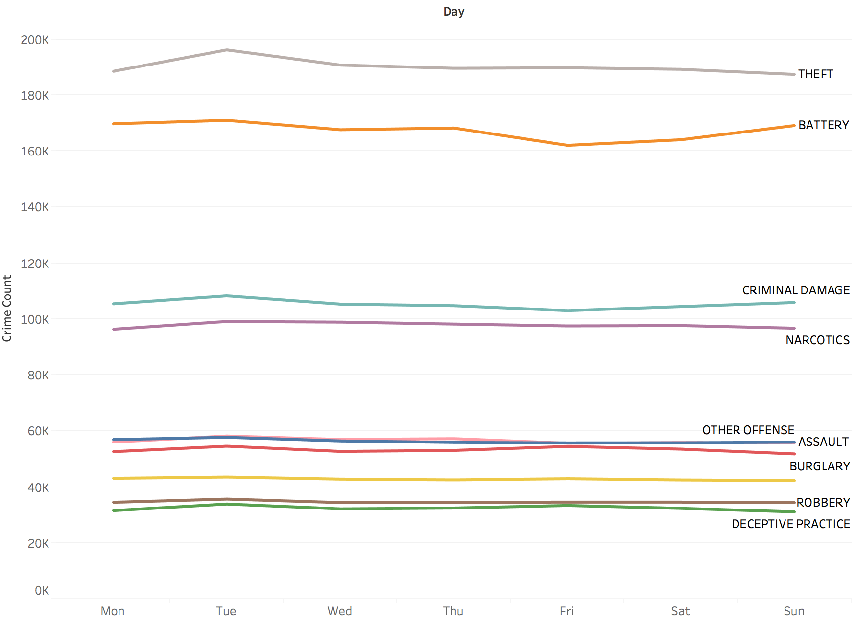
Chicago Crime Overview, by Day

Slide 27
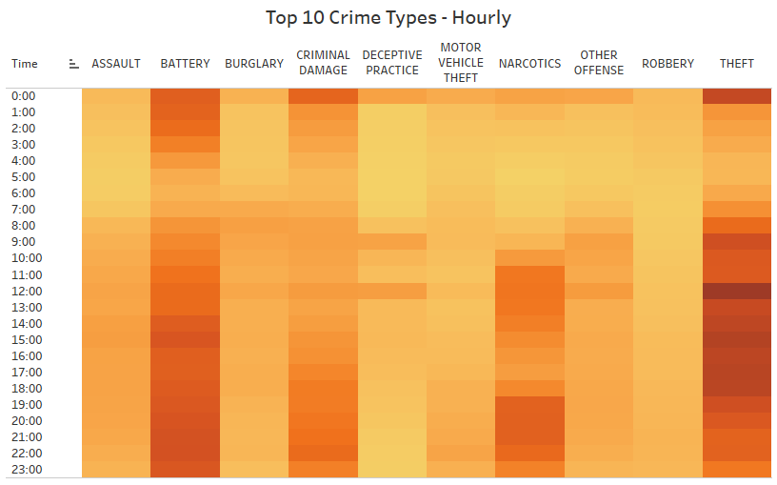
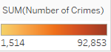
Chicago Top 10 Crime Types - Hourly

Slide 28
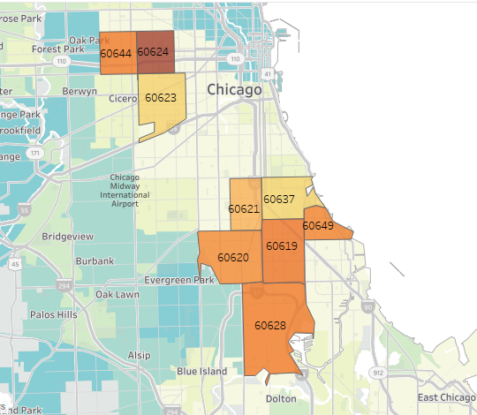
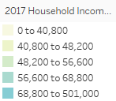
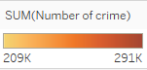
Crime Overview in Chicago Top 10 Zipcodes

Slide 29
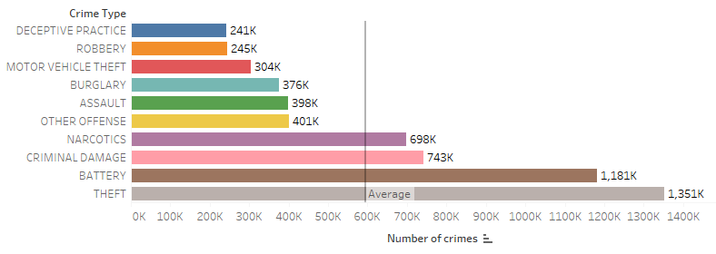
Los Angeles
Average around 105K
Average around 440K
New York
Chicago
Average around 600K

Slide 30
In Comparison
Crime Severity (in average): Chicago (most dangerous) > New York > Los Angeles > (safest)
However, theft-related crime is the common crime type among 3 cities
Crimes can be committed anytime throughout the day
Economic situation is undeniably one of the most important factor that caused people to commit crimes
Generally, crime will always present when population density is high

Slide 31
Github Link
https://github.com/ngupta8/5200-Project/upload/master

Slide 32
References
Crime Facts: http://www.areavibes.com/los+angeles-ca/crime/
http://www.areavibes.com/new+york-ny/crime/
http://www.areavibes.com/chicago-il/crime/ Basic Reverse Geocoding : http://download.geonames.org/export/zip/
https://stackoverflow.com/questions/5981502/select-the-closest-pair-from-a-list
https://stackoverflow.com/questions/27027885/slice-list-of-floats-by-value-in-python

Slide 33
Thank You!

